Slide 1
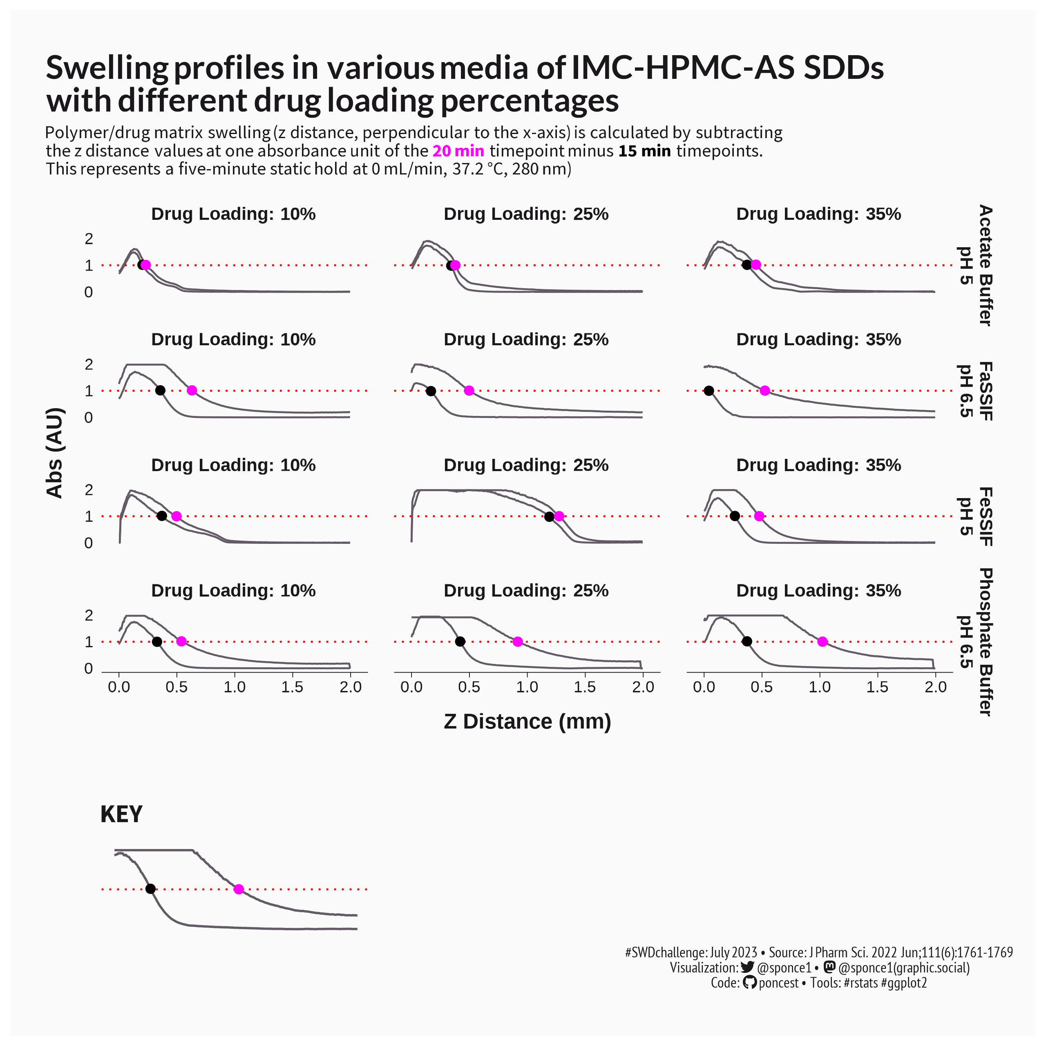
 15 min
 20 min
1AU
IMC – indomethacin,
HPMC-AS - hydroxypropyl methylcellulose acetate succinate
FaSSIF - fasted state simulated intestinal fluid,
FeSSIF - fed state simulated intestinal fluid

